Slide 1
Assignment 3B: AI-Enabled Workflow for Project Helio-Twin
BY – Satvik Shrivastava

Slide 2

01. Identify the AI Use Case
Where in your system can AI be applied? The AI operates as a "System of Systems" across three distinct layers:
The Edge Layer (Hardware): Directly on the solar inverter gateway.
The Cloud Layer (Analytics): In the central data repository.
The Interface Layer (Human): Between the raw data and the campus maintenance staff.
What problem will AI solve there? Traditional solar monitoring (SCADA) relies on "static thresholds" (e.g., an alarm sounds if power drops below 10kW). This is deeply flawed. At 8:00 AM, 10kW is normal; at 1:00 PM, 10kW is a catastrophic failure. AI solves this by providing Contextual Intelligence. It correlates real-time power output with live solar irradiance, temperature, and historical data to know exactly what the power should be at any given second. It eliminates the "Ghost Generation" blind spots and prevents "Alarm Fatigue" (where staff ignore alerts because there are too many false positives).

Slide 3
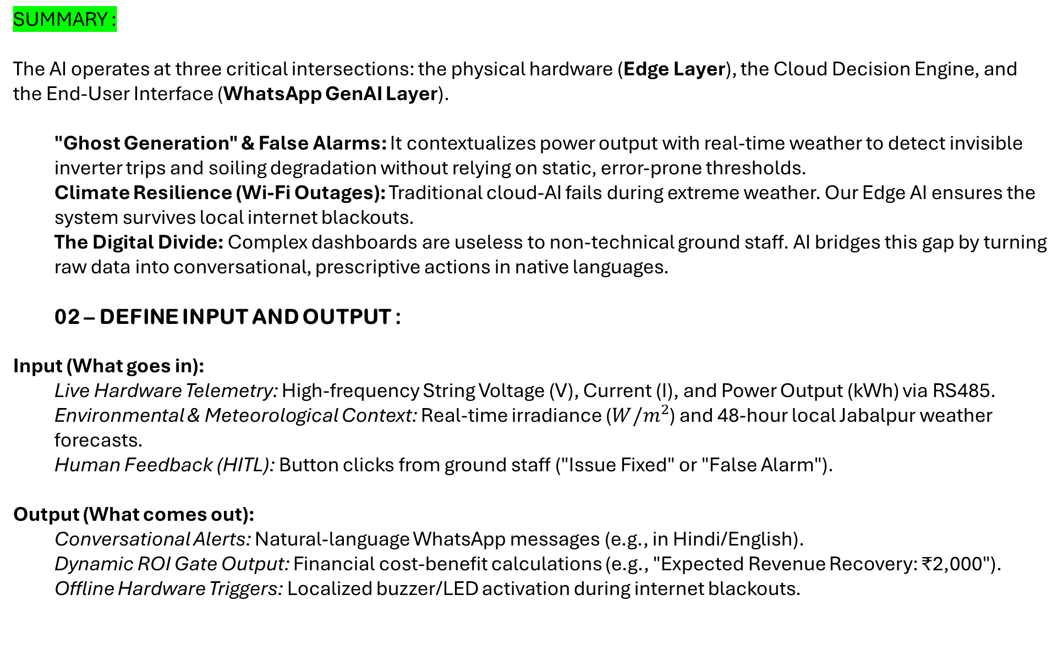
SUMMARY :
The AI operates at three critical intersections: the physical hardware (Edge Layer), the Cloud Decision Engine, and the End-User Interface (WhatsApp GenAI Layer).
"Ghost Generation" & False Alarms: It contextualizes power output with real-time weather to detect invisible inverter trips and soiling degradation without relying on static, error-prone thresholds.
Climate Resilience (Wi-Fi Outages): Traditional cloud-AI fails during extreme weather. Our Edge AI ensures the system survives local internet blackouts.
The Digital Divide: Complex dashboards are useless to non-technical ground staff. AI bridges this gap by turning raw data into conversational, prescriptive actions in native languages.
02 – DEFINE INPUT AND OUTPUT :
Input (What goes in):
Live Hardware Telemetry: High-frequency String Voltage (V), Current (I), and Power Output (kWh) via RS485.
Environmental & Meteorological Context: Real-time irradiance ($W/m^{2}$) and 48-hour local Jabalpur weather forecasts.
Human Feedback (HITL): Button clicks from ground staff ("Issue Fixed" or "False Alarm").
Output (What comes out):
Conversational Alerts: Natural-language WhatsApp messages (e.g., in Hindi/English).
Dynamic ROI Gate Output: Financial cost-benefit calculations (e.g., "Expected Revenue Recovery: ₹2,000").
Offline Hardware Triggers: Localized buzzer/LED activation during internet blackouts.

Slide 4
02. Define Input and Output (With Data Structures)
Inputs (What goes into the AI):
Hardware Telemetry: {"timestamp": "2026-06-25T13:00:00", "inverter_id": 2, "voltage_V": 620, "current_A": 0, "power_kW": 0}
Environmental Context: {"irradiance_W_m2": 850, "panel_temp_C": 42, "humidity": 65}
Weather Forecast API: {"jabalpur_forecast_24h": "Heavy Monsoon Rain"}
Human Feedback (HITL): {"alert_id": 402, "user_feedback": "False Alarm"}
Outputs (What the AI generates):
JSON Decision Payload: {"status": "Anomaly", "confidence": 0.96, "root_cause": "Grid Surge Trip", "financial_loss_rate": "₹50/hr"}
Physical Edge Output: GPIO Pin HIGH (Triggers a physical red LED / buzzer at the Jabalpur campus substation).
GenAI WhatsApp Output: "Helio Alert: Inverter 2 is offline despite high sunlight. ₹50/hr is being lost. Please physically reset the breaker."

Slide 5
03. Define the Type of AI
This system uses a Hybrid AI Architecture to ensure reliability:
Core Engine: Anomaly Detection (Isolation Forest)
Why? We do not have labeled datasets of past inverter failures. Isolation Forest is an unsupervised algorithm that builds decision trees to "isolate" unusual data points. It quickly learns the normal daily solar curve and mathematically flags any point that deviates from it.
Resilience Engine: TinyML (Edge AI)
Why? Cloud AI is useless if the Jabalpur campus Wi-Fi drops during a monsoon. We compress a lightweight TensorFlow Lite neural network onto the local ESP32 chip. It runs inference offline, ensuring the campus is always protected.
Communication Engine: Retrieval-Augmented Generation (RAG LLM)
Why? Large Language Models (like ChatGPT) can hallucinate. By using RAG, we restrict the AI to only answer based on our live JSON telemetry and campus O&M manuals. This allows Vijay to chat with the system safely without needing to understand data dashboards.

Slide 6
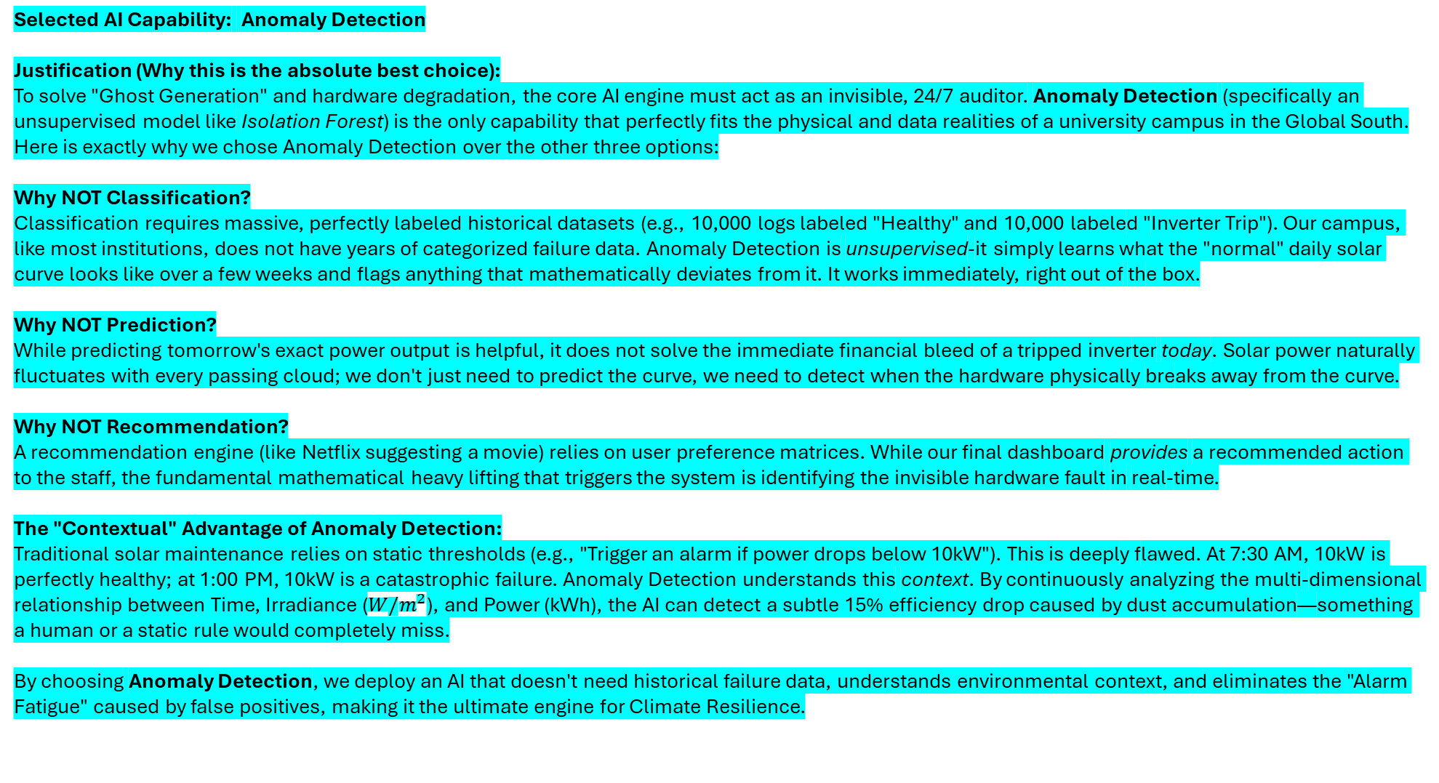
Selected AI Capability: Anomaly Detection
Justification (Why this is the absolute best choice): To solve "Ghost Generation" and hardware degradation, the core AI engine must act as an invisible, 24/7 auditor. Anomaly Detection (specifically an unsupervised model like Isolation Forest) is the only capability that perfectly fits the physical and data realities of a university campus in the Global South.
Here is exactly why we chose Anomaly Detection over the other three options:
Why NOT Classification? Classification requires massive, perfectly labeled historical datasets (e.g., 10,000 logs labeled "Healthy" and 10,000 labeled "Inverter Trip"). Our campus, like most institutions, does not have years of categorized failure data. Anomaly Detection is unsupervised-it simply learns what the "normal" daily solar curve looks like over a few weeks and flags anything that mathematically deviates from it. It works immediately, right out of the box.
Why NOT Prediction? While predicting tomorrow's exact power output is helpful, it does not solve the immediate financial bleed of a tripped inverter today. Solar power naturally fluctuates with every passing cloud; we don't just need to predict the curve, we need to detect when the hardware physically breaks away from the curve.
Why NOT Recommendation? A recommendation engine (like Netflix suggesting a movie) relies on user preference matrices. While our final dashboard provides a recommended action to the staff, the fundamental mathematical heavy lifting that triggers the system is identifying the invisible hardware fault in real-time.
The "Contextual" Advantage of Anomaly Detection: Traditional solar maintenance relies on static thresholds (e.g., "Trigger an alarm if power drops below 10kW"). This is deeply flawed. At 7:30 AM, 10kW is perfectly healthy; at 1:00 PM, 10kW is a catastrophic failure. Anomaly Detection understands this context. By continuously analyzing the multi-dimensional relationship between Time, Irradiance ($W/m^{2}$), and Power (kWh), the AI can detect a subtle 15% efficiency drop caused by dust accumulation—something a human or a static rule would completely miss.
By choosing Anomaly Detection, we deploy an AI that doesn't need historical failure data, understands environmental context, and eliminates the "Alarm Fatigue" caused by false positives, making it the ultimate engine for Climate Resilience.

Slide 7
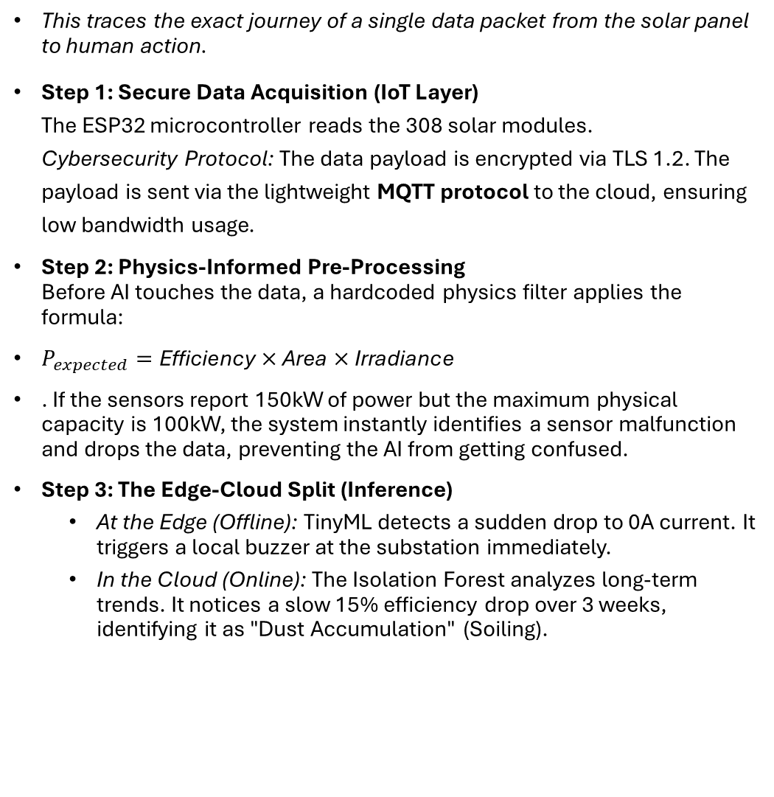
04. Create the AI Workflow (The Step-by-Step Data Path)
Step 4: The Dynamic ROI Gate (Financial Intelligence) The Cloud AI prepares to send a "Clean the Panels" alert. However, it first runs a script to fetch the Jabalpur meteorological forecast.
Logic Check: Tomorrow = Heavy Rain.
Economic Decision: Cost of manual cleaning (₹500) > Cost of waiting 24 hours (₹100 lost energy).
Action: Alert suppressed. State updated to "Awaiting Natural Wash."
Step 5: Conversational Action (GenAI) If a real fault (like a trip) occurs, the RAG LLM ingests the JSON payload and drafts a localized WhatsApp message.
Message: “User, Inverter #1 tripped. Estimated loss if not fixed today: ₹400."
Step 6: Continuous Learning (MLOps / HITL) Under the WhatsApp message are two interactive buttons: [Fixed] or [False Alarm]. If User clicks [False Alarm] (e.g., a temporary shadow from a construction crane triggered the system), the timestamped data is sent back to the Isolation Forest model. The model automatically adjusts its weights, learning that this specific shadow pattern is "normal," ensuring the false alarm never happens again.
This traces the exact journey of a single data packet from the solar panel to human action.
Step 1: Secure Data Acquisition (IoT Layer) The ESP32 microcontroller reads the 308 solar modules. Cybersecurity Protocol: The data payload is encrypted via TLS 1.2. The payload is sent via the lightweight MQTT protocol to the cloud, ensuring low bandwidth usage.
Step 2: Physics-Informed Pre-Processing Before AI touches the data, a hardcoded physics filter applies the formula:
$P_{expected}=\text{Efficiency}×\text{Area}×\text{Irradiance}$
. If the sensors report 150kW of power but the maximum physical capacity is 100kW, the system instantly identifies a sensor malfunction and drops the data, preventing the AI from getting confused.
Step 3: The Edge-Cloud Split (Inference)
At the Edge (Offline): TinyML detects a sudden drop to 0A current. It triggers a local buzzer at the substation immediately.
In the Cloud (Online): The Isolation Forest analyzes long-term trends. It notices a slow 15% efficiency drop over 3 weeks, identifying it as "Dust Accumulation" (Soiling).

Slide 8

Click the links for WORKFLOW diagram :
https://mermaid.ai/d/886b09e0-8e60-4adf-b16a-a6961861120b
https://miro.com/app/board/uXjVHBkb8Z4=/?share_link_id=138135549011
05. Suggest Tools and Platforms
This stack is chosen for Frugal Innovation-proving it can be affordably deployed by university students using modern tech.
IoT & Edge Compute:
Hardware: ESP32-WROOM-32 microcontroller (₹500) + RS485-to-TTL module (₹300).
Edge AI Tool: Edge Impulse (Free platform to train and compress ML models into C++ libraries for microcontrollers).
Data Pipeline & Security:
Broker: Eclipse Mosquitto (Open-source MQTT broker for fast, secure IoT messaging).
Database: Firebase Realtime Database (Handles fast, unstructured JSON streams effortlessly).
Cloud AI & Analytics:
ML Framework: Scikit-Learn (Python) for the Isolation Forest algorithm.
Weather Data: NASA POWER API (Free, reliable satellite irradiance data).
User Interface & GenAI:
Dashboard: Streamlit (Python library to build web apps in minutes).
Conversational AI: Llama 3 (via Groq API) for ultra-fast, free, open-source language generation.
Messaging: Twilio WhatsApp API for seamless integration with staff mobile phones.

Slide 9
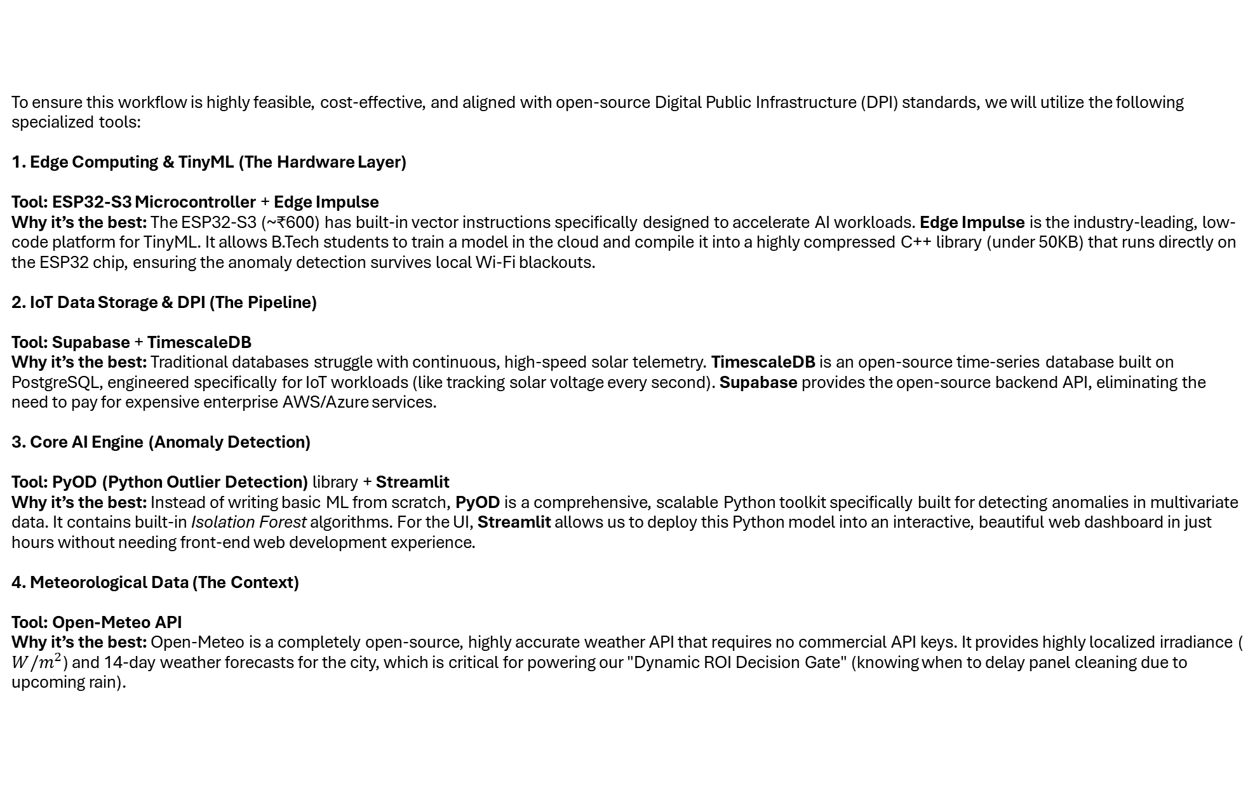
To ensure this workflow is highly feasible, cost-effective, and aligned with open-source Digital Public Infrastructure (DPI) standards, we will utilize the following specialized tools: 1. Edge Computing & TinyML (The Hardware Layer) Tool: ESP32-S3 Microcontroller + Edge Impulse Why it’s the best: The ESP32-S3 (~₹600) has built-in vector instructions specifically designed to accelerate AI workloads. Edge Impulse is the industry-leading, low-code platform for TinyML. It allows B.Tech students to train a model in the cloud and compile it into a highly compressed C++ library (under 50KB) that runs directly on the ESP32 chip, ensuring the anomaly detection survives local Wi-Fi blackouts. 2. IoT Data Storage & DPI (The Pipeline) Tool: Supabase + TimescaleDB Why it’s the best: Traditional databases struggle with continuous, high-speed solar telemetry. TimescaleDB is an open-source time-series database built on PostgreSQL, engineered specifically for IoT workloads (like tracking solar voltage every second). Supabase provides the open-source backend API, eliminating the need to pay for expensive enterprise AWS/Azure services. 3. Core AI Engine (Anomaly Detection) Tool: PyOD (Python Outlier Detection) library + Streamlit Why it’s the best: Instead of writing basic ML from scratch, PyOD is a comprehensive, scalable Python toolkit specifically built for detecting anomalies in multivariate data. It contains built-in Isolation Forest algorithms. For the UI, Streamlit allows us to deploy this Python model into an interactive, beautiful web dashboard in just hours without needing front-end web development experience. 4. Meteorological Data (The Context) Tool: Open-Meteo API Why it’s the best: Open-Meteo is a completely open-source, highly accurate weather API that requires no commercial API keys. It provides highly localized irradiance ( $W/m^{2}$) and 14-day weather forecasts for the city, which is critical for powering our "Dynamic ROI Decision Gate" (knowing when to delay panel cleaning due to upcoming rain).

Slide 10
5. Conversational AI & Action (The RAG Layer) Tool: LangChain + Llama 3 (via Groq API) + WhatsApp Cloud API Why it’s the best: To build the GenAI chatbot, we use LangChain to orchestrate the Retrieval-Augmented Generation (RAG). We run Meta's open-source Llama 3 model using the Groq API. Groq uses specialized LPU (Language Processing Unit) chips rather than GPUs, making inference blazing fast and highly energy-efficient (low carbon footprint)—a massive bonus for a sustainability pitch. The output is pushed natively to the staff via the official Meta WhatsApp Cloud API. Future-Proofing Mechanisms - Masterstroke 1: Add "Federated Learning" for Global Scaling The Missing Piece: If you scale Helio-Twin to 500 different universities across India or the Global South, sending all their raw, private energy data to a central cloud server is extremely expensive and a data-privacy nightmare. The Upgrade: Mention Federated Learning. How it works: Instead of sharing raw data, each university campus trains its own AI model locally. Once a week, the campus only uploads the learned AI weights (the math) to a central UN/Open-Source hub. What to write in your submission (Under AI Type or Scalability): "To scale Helio-Twin globally as a Digital Public Good, we will utilize Federated Learning. If our campus in encounters a new type of monsoon cloud anomaly, our local model learns it and shares only the updated algorithmic weights with the global network. This means a university in Kenya instantly gets a smarter AI without ever sharing their private institutional data, ensuring strict Data Sovereignty.“ Masterstroke 2: Combating "Sensor Drift“ The Missing Piece: AI models assume the hardware is perfect. But over 5 years, the IoT sensors will physically degrade and start reading 5% lower due to heat and wear. A basic AI will constantly trigger "Dust Soiling" alerts, not realizing the sensor itself is dying. The Upgrade: Add a "Sensor Drift Auto-Calibration" loop. What to write (Under Step 2 of your Workflow): "To ensure decade-long reliability, the Physics-Informed layer includes Sensor Drift tracking. By cross-referencing our hardware voltage with highly calibrated NASA satellite irradiance over months, the AI can detect if the physical IoT sensor is

Slide 11
degrading, automatically calibrating its baseline to prevent false alarms as the hardware ages." Masterstroke 3: Behavioral Gamification (The Human Motivation Layer) The Missing Piece: You built a great WhatsApp bot, but how do you make sure the overworked ground staff actually care about responding to it? The Upgrade: Program the GenAI LLM to gamify their work and connect it directly to carbon savings. What to write (Under Step 4/GenAI Action): "To drive adoption, the RAG LLM integrates behavioral gamification. When maintenance staff clear a fault, the WhatsApp bot does not just send a receipt; it translates their labor into direct climate impact. Example response: 'Great job, User! By resetting Inverter #2 today, you personally saved the campus ₹800 and prevented 12 kg of coal CO₂ emissions. You are currently #1 on the Campus Green Leaderboard for this month!’” FUTURE UPGRADES - Multimodal Edge AI (Vision + Telemetry) Instead of just relying on the power dropping to guess if there is dust, we give the AI "eyes.“ 1. Update the "Input" Section Add Visual Data: Along with the RS485 electrical telemetry and weather APIs, Helio-Twin ingests image data from ultra-low-cost ESP32-CAM modules (costing ~₹400) mounted on the edges of the solar arrays. 2. Update the "Type of AI" Section You are now using a Multimodal AI Architecture: For Electrical Faults (Inverter Trips): Isolation Forest (Anomaly Detection). For Physical Faults (Dust, Bird Waste, Leaves): YOLO (You Only Look Once) Nano or MobileNetV2 (Computer Vision / Image Classification).

Slide 12
3. Update the "Workflow" (How it processes Bird Waste/Dust) Add this specific visual pipeline to your workflow: Capture: The ESP32-CAM takes a photo of the solar array every 6 hours. Edge Vision Processing: A compressed YOLO computer vision model runs directly on the ESP32 chip. It scans the image specifically looking for high-contrast pixels (bird droppings) or a brown gradient filter (dust accumulation). Fusion & Verification: The AI cross-references the camera. Vision AI says: "Panel 4 has heavy bird waste." Telemetry AI says: "Panel 4 power output dropped by 8%." The AI now has 100% confidence. Action: The GenAI WhatsApp bot texts User: "Visual confirmation of heavy bird soiling on Array B. Output is down 8%. Please clean." (You can even program the bot to send the annotated photo to User's WhatsApp!). 4. Update the "Tools" Section Add ESP32-CAM: The physical hardware for frugal vision. Add YOLO (Nano version) / Edge Impulse: The perfect tools for running computer vision on microcontrollers without needing the cloud. "Self-Healing" Material with AI Digital Twin Instead of just alerting a human to fix a crack, your system predicts the damage and manages automated mitigation. The Concept: You pair your software with advanced self-healing polymers or localized liquid-crystal coatings applied to the panels. How it works: Your AI detects a micro-crack or a heavy scratch from a storm. Instead of sending a technician, the AI triggers a localized electrical micro-current or thermal pulse to the panel, activating the self-healing properties of the coating to seal the crack automatically. A closed-loop, autonomous maintenance system that fixes physical damage without human intervention. Acoustic & Vibration "Listening" AI (Continuous Edge Monitoring) Visual AI only sees a problem after it happens. Acoustic AI hears a problem as it is forming. The Concept: Attaching low-cost, weather-proof contact microphones or piezoelectric sensors to the underside of the panel racks. How it works: The AI is trained on the acoustic signatures of structural health. It can "hear" a microscopic fracture forming inside the silicon before it becomes a visible crack. It can detect the exact frequency of a loose mounting screw vibrating in the wind, or the sound of internal electrical arcing inside a junction box long before a thermal camera detects a hotspot. 24/7 continuous, non-visual health monitoring that catches failures at the molecular or mechanical level before they are visible to drones.

Slide 13
Bio-Mimetic Dust & Waste Repulsion (Dynamic Deflection): Instead of cleaning dust and bird waste after it lands, prevent it from landing using active AI defense. The Concept: An AI-controlled, ultra-low-power electrostatic or ultrasonic acoustic wave system embedded in the panel frame. How it works: Your edge-AI camera detects a dust cloud approaching or birds circling overhead. It instantly activates an optimized, microscopic electrostatic field across the glass surface. This field physically repels incoming dust particles and prevents bird droppings from adhering to the glass, causing them to slide right off. Dynamic, active defense that modifies the physics of the panel surface in real-time based on immediate environmental threats. THANK YOU!

